Slide 1
Recursion

Slide 2
Why we need recursion
Recursion is a programming and problem-solving technique where a function calls itself to solve a smaller instance of the same problem. Recursion is a powerful and essential concept in computer science and programming for several reasons:
1. Solving complex problems: Recursion is particularly useful for solving problems that have a recursive or self-referential structure. These problems can be challenging to solve using iterative approaches, making recursion a more natural choice.

Slide 3
2. Simplifying code: Recursive solutions often lead to more concise and elegant code. They can make complex problems easier to understand and maintain by breaking them down into smaller, more manageable subproblems.
3. Handling tree-like structures: Recursion is well-suited for working with hierarchical data structures like trees and graphs. Many algorithms for tree traversal, searching, and manipulation rely on recursion.

Slide 4
4. Divide and conquer: Recursive algorithms often follow a "divide and conquer" strategy, where a problem is divided into smaller subproblems, solved recursively, and then combined to solve the original problem. This approach can lead to efficient solutions for a wide range of problems.
5. Functionality reuse: Recursive functions can be more reusable because they are designed to work on smaller instances of the same problem. Once you have a working recursive function, you can often use it in different contexts without significant modifications.

Slide 5
6. Mathematical modeling: Many mathematical problems and concepts are naturally recursive, making recursion a valuable tool for modeling and solving mathematical challenges.
7. Simplicity in certain cases: Some problems have recursive definitions or are inherently recursive in nature, making it more straightforward to use recursion to address them.

Slide 6
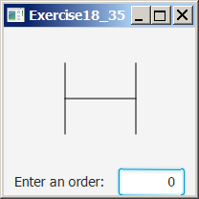
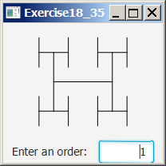
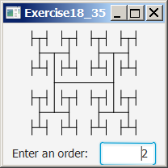
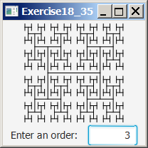
Motivations
H-trees, depicted in Figure 18.1, are used in a very large-scale integration (VLSI) design as a clock distribution network for routing timing signals to all parts of a chip with equal propagation delays. How do you write a program to display H-trees? A good approach is to use recursion.

Slide 7

Computing Factorial
factorial(0) = 1;
factorial(n) = n*factorial(n-1);
n! = n * (n-1)!
ComputeFactorial

Slide 8
Computing Factorial
animation
factorial(0) = 1;
factorial(n) = n*factorial(n-1);
factorial(4)

Slide 9
Computing Factorial
animation
factorial(0) = 1;
factorial(n) = n*factorial(n-1);
factorial(4) = 4 * factorial(3)

Slide 10
Computing Factorial
animation
factorial(0) = 1;
factorial(n) = n*factorial(n-1);
factorial(4) = 4 * factorial(3)
= 4 * 3 * factorial(2)

Slide 11
Computing Factorial
animation
factorial(0) = 1;
factorial(n) = n*factorial(n-1);
factorial(4) = 4 * factorial(3)
= 4 * 3 * factorial(2)
= 4 * 3 * (2 * factorial(1))

Slide 12
Computing Factorial
animation
factorial(0) = 1;
factorial(n) = n*factorial(n-1);
factorial(4) = 4 * factorial(3)
= 4 * 3 * factorial(2)
= 4 * 3 * (2 * factorial(1))
= 4 * 3 * ( 2 * (1 * factorial(0)))

Slide 13
Computing Factorial
animation
factorial(0) = 1;
factorial(n) = n*factorial(n-1);
factorial(4) = 4 * factorial(3)
= 4 * 3 * factorial(2)
= 4 * 3 * (2 * factorial(1))
= 4 * 3 * ( 2 * (1 * factorial(0)))
= 4 * 3 * ( 2 * ( 1 * 1)))

Slide 14
Computing Factorial
animation
factorial(0) = 1;
factorial(n) = n*factorial(n-1);
factorial(4) = 4 * factorial(3)
= 4 * 3 * factorial(2)
= 4 * 3 * (2 * factorial(1))
= 4 * 3 * ( 2 * (1 * factorial(0)))
= 4 * 3 * ( 2 * ( 1 * 1)))
= 4 * 3 * ( 2 * 1)

Slide 15
Computing Factorial
animation
factorial(0) = 1;
factorial(n) = n*factorial(n-1);
factorial(4) = 4 * factorial(3)
= 4 * 3 * factorial(2)
= 4 * 3 * (2 * factorial(1))
= 4 * 3 * ( 2 * (1 * factorial(0)))
= 4 * 3 * ( 2 * ( 1 * 1)))
= 4 * 3 * ( 2 * 1)
= 4 * 3 * 2

Slide 16
Computing Factorial
animation
factorial(0) = 1;
factorial(n) = n*factorial(n-1);
factorial(4) = 4 * factorial(3)
= 4 * 3 * factorial(2)
= 4 * 3 * (2 * factorial(1))
= 4 * 3 * ( 2 * (1 * factorial(0)))
= 4 * 3 * ( 2 * ( 1 * 1)))
= 4 * 3 * ( 2 * 1)
= 4 * 3 * 2
= 4 * 6

Slide 17
Computing Factorial
animation
factorial(0) = 1;
factorial(n) = n*factorial(n-1);
factorial(4) = 4 * factorial(3)
= 4 * 3 * factorial(2)
= 4 * 3 * (2 * factorial(1))
= 4 * 3 * ( 2 * (1 * factorial(0)))
= 4 * 3 * ( 2 * ( 1 * 1)))
= 4 * 3 * ( 2 * 1)
= 4 * 3 * 2
= 4 * 6
= 24

Slide 18


Trace Recursive factorial
animation
Executes factorial(4)

Slide 19
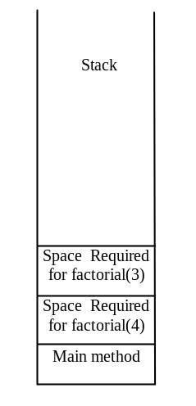
Trace Recursive factorial
animation
Executes factorial(3)

Slide 20
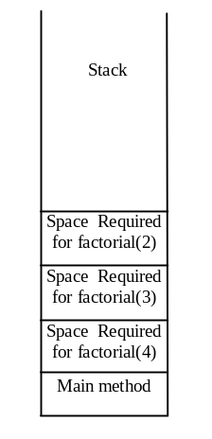
Trace Recursive factorial
animation
Executes factorial(2)

Slide 21
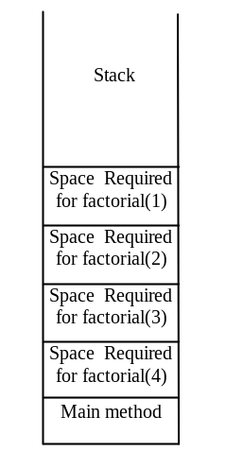
Trace Recursive factorial
animation
Executes factorial(1)

Slide 22
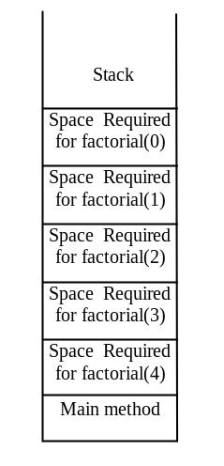
Trace Recursive factorial
animation
Executes factorial(0)

Slide 23
Trace Recursive factorial
animation
returns 1

Slide 24
Trace Recursive factorial
animation
returns factorial(0)

Slide 25
Trace Recursive factorial
animation
returns factorial(1)

Slide 26

Trace Recursive factorial
animation
returns factorial(2)

Slide 27
Trace Recursive factorial
animation
returns factorial(3)

Slide 28
Trace Recursive factorial
animation
returns factorial(4)

Slide 29

factorial(4) Stack Trace

Slide 30
Other Examples
f(0) = 0;
f(n) = n + f(n-1);

Slide 31
Fibonacci Numbers
Fibonacci series: 0 1 1 2 3 5 8 13 21 34 55 89…
indices: 0 1 2 3 4 5 6 7 8 9 10 11
fib(0) = 0;
fib(1) = 1;
fib(index) = fib(index -1) + fib(index -2); index >=2
fib(3) = fib(2) + fib(1) = (fib(1) + fib(0)) + fib(1) = (1 + 0) +fib(1) = 1 + fib(1) = 1 + 1 = 2
ComputeFibonacci

Slide 32

Fibonnaci Numbers, cont.

Slide 33
Characteristics of Recursion
All recursive methods have the following characteristics:
  One or more base cases (the simplest case) are used to stop recursion.
  Every recursive call reduces the original problem, bringing it increasingly closer to a base case until it becomes that case.
In general, to solve a problem using recursion, you break it into subproblems. If a subproblem resembles the original problem, you can apply the same approach to solve the subproblem recursively. This subproblem is almost the same as the original problem in nature with a smaller size.

Slide 34
Recursive Selection Sort
Find the smallest number in the list and swaps it with the first number.
Ignore the first number and sort the remaining smaller list recursively.
RecursiveSelectionSort

Slide 35
Recursive Binary Search
Case 1: If the key is less than the middle element, recursively search the key in the first half of the array.
Case 2: If the key is equal to the middle element, the search ends with a match.
Case 3: If the key is greater than the middle element, recursively search the key in the second half of the array.
RecursiveBinarySearch

Slide 36
Recursive Implementation
/** Use binary search to find the key in the list */
public static int recursiveBinarySearch(int[] list, int key) {
int low = 0;
int high = list.length - 1;
return recursiveBinarySearch(list, key, low, high);
}
/** Use binary search to find the key in the list between
list[low] list[high] */
public static int recursiveBinarySearch(int[] list, int key,
int low, int high) {
if (low > high) // The list has been exhausted without a match
return -low - 1;
int mid = (low + high) / 2;
if (key < list[mid])
return recursiveBinarySearch(list, key, low, mid - 1);
else if (key == list[mid])
return mid;
else
return recursiveBinarySearch(list, key, mid + 1, high);
}

Slide 37
Recursion vs. Iteration
Recursion is an alternative form of program control. It is essentially repetition without a loop.
Recursion bears substantial overhead. Each time the program calls a method, the system must assign space for all of the method’s local variables and parameters. This can consume considerable memory and requires extra time to manage the additional space.

Slide 38
Why recursion?
Here are some reasons why keeping track of recursion states or specific points within a recursive function might be important:
Problem Solving: In many cases, recursive functions are used to solve complex problems by breaking them down into smaller, more manageable sub-problems. Keeping track of the recursion state allows the function to remember where it is in the problem-solving process.

Slide 39
Backtracking: Recursive algorithms often involve exploring multiple branches or possibilities. For example, in a recursive tree traversal, you may need to visit nodes in a specific order. By keeping track of the recursion state, you can backtrack and explore other possibilities if needed.
Efficiency: Some recursive algorithms can be optimized by avoiding redundant calculations. Storing and reusing previously computed values from a specific recursion state can improve efficiency, as it reduces the need to recalculate the same values.

Slide 40
Debugging: When debugging a recursive function, it can be helpful to know the current state of the function at any given point. This information can aid in identifying and fixing errors or unexpected behavior.
Resource Management: In some cases, recursion can lead to stack overflow errors if not managed properly. Keeping track of the recursion state can help you monitor and control the depth of recursion to avoid such issues.
Complex Data Structures: Recursive algorithms are often used with complex data structures like trees and graphs. Maintaining a recursion state allows you to navigate and manipulate these data structures effectively.

